Slide 1
Mid-Project Reviews
Indoor Drone
Group 9

Slide 2
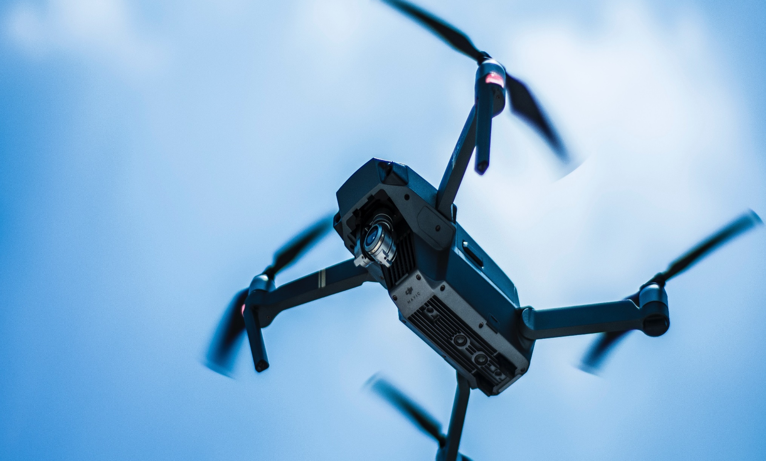

Project Stages
Progress
Finish soldering electrical parts
Created a simulated environment
Basic function commands
Assembled Drone version 2
Test-cases performed on the simulated drone

Slide 3

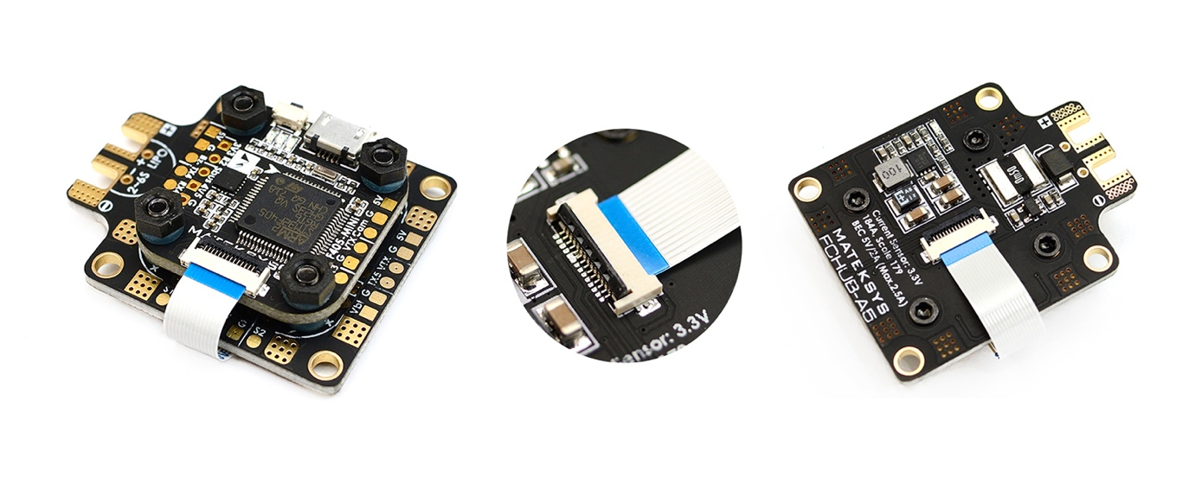
Drone version 1
Matek F405-mini
Pros
Wide used.
Firmware is supported with Betaflight (open source platform)
Can connect with camera for further usages
Having video transmitter feature
Small and light, suitable for small drone
Cons
It is hard to access the firmware to adjust the code inside and debug
Because this type of board usually using for racing or entertainment purpose, we could not find any support resources. So, it is hard for us to modify the FC.
It is small so it’s very difficult for us soldering things together
Not supported for stage 2 (autopilot controlling)

Slide 4



Drone version 2
Drone v1.0
With what we’ve learned and available resources
Automated
Support customization and better automation capability
Semi-automated
Drone
New flight controller
A new controller that fits our requirements

Slide 5

Progress
List achievements and progress since last status update was given
Highlight those things that made progress possible
Address schedule implications

Slide 6

Schedule
List top high-level dates
Distribute more detailed schedule if appropriate
Keep simple so audience does not get distracted with details
Make sure you are familiar with details of schedule so you can answer questions

Slide 7

Deliveries
List main critical deliverables
Understand your confidence rating to each deliverable
Yours to client
Yours to outside services
Outside services to you
Other departments to you
Indicate confidence level on slides if appropriate

Slide 8

Costs
List new projections of costs
If there are cost overruns
Include original estimates
Understand source of differences in these numbers – be ready for questions
Summarize why
List corrective or preventative action you’ve taken
Set realistic expectations for future expenditures

Slide 9

Technology
List technical problems that have been solved
List any dubious technological dependencies for project
Indicate source of doubt
Summarize action being taken or back up plan
List outstanding technical issues that need to be solved
Summarize their impact on the project

Slide 10

Resources
Summarize project resources
Understand that customers may want to be assured that all possible resources are being used, but in such a way that costs will be properly managed
Dedicated (full-time) resources
Part-time resources
If project is constrained by lack of resources, suggest alternatives

Slide 11

Goals for Next Review
Date of next status update
Make sure anyone involved in project understands action plan
List goals for next review
Specific items that will be done
Issues that will be resolved

